Slide 1
VPC Enhancements
What’s New in Public Cloud
March 11th , 2021
Peri Bhaskar

Slide 2
IBM Cloud® Application Load Balancer on VPC (ALB)
Available MZR Geographies:
US-South DAL
US-East WDC
EU-DE
EU-FR, EU-FR2
EU-GB
JP-TOK, JP-OSA
AU-SYD
Website & External Docs:
Website:
https://www.ibm.com/cloud/load-balancer
Docs:
https://cloud.ibm.com/docs/vpc?topic=vpc-alb-integration-with-security-groups
Seismic:
https:// ibm.biz/sell-vpc
Now allows you to attach security groups to enhance your application's security.
Customer Benefits:
A convenient way to secure the ALB instances.
Full control over ingress and egress traffic to and from the load balancer's listeners
Tighten the security posture of the load balancers' back-end targets.
Market:
Large Enterprises with sensitive application workloads like SAP and HR applications
IBM is modernizing our VPC Infrastructure to be more competitive with AWS, Microsoft and Google with our networking platform for public cloud.
This announcement completes another important milestone of the VPC Networking Roadmap and will help with accelerating customer’s VPC adoption

Slide 3
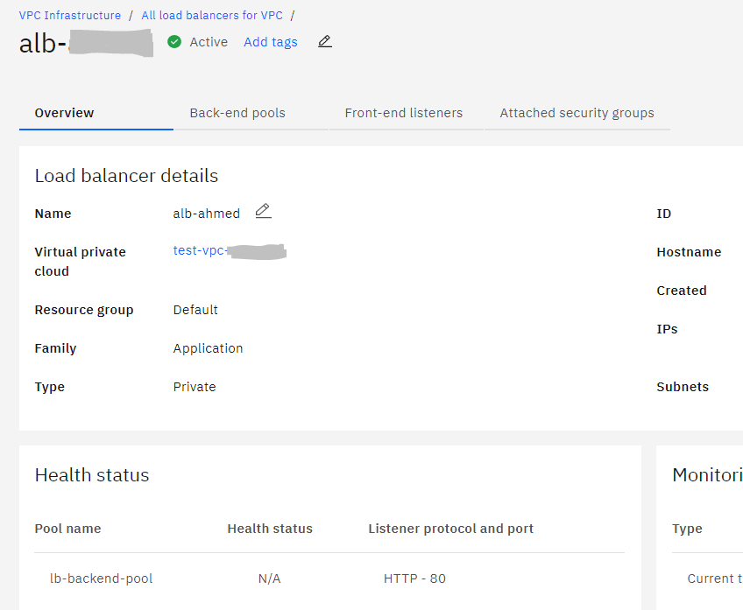
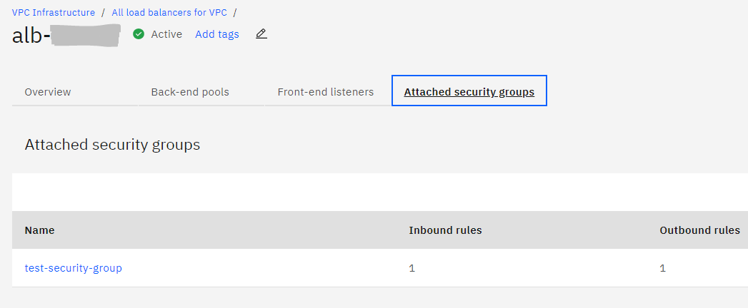
Security Groups
Application Load Balancer (ALB) now supports Security Groups.
By default, the rules defined in Security Groups will allow specified traffic and block everything that is not specified.
For example: A public ALB has a security group rule to allow TCP traffic over Port 443 from Any Source. All other traffic will automatically be blocked.
Security Group Rules are Stateful. If an Ingress Rule specifies Allowed Traffic, the Egress traffic will automatically be Allowed without requiring an egress rule.
NOTE: Load balancers created prior to 25 February 2021 do not have a security group attached and allow all inbound and outbound traffic.

Slide 4
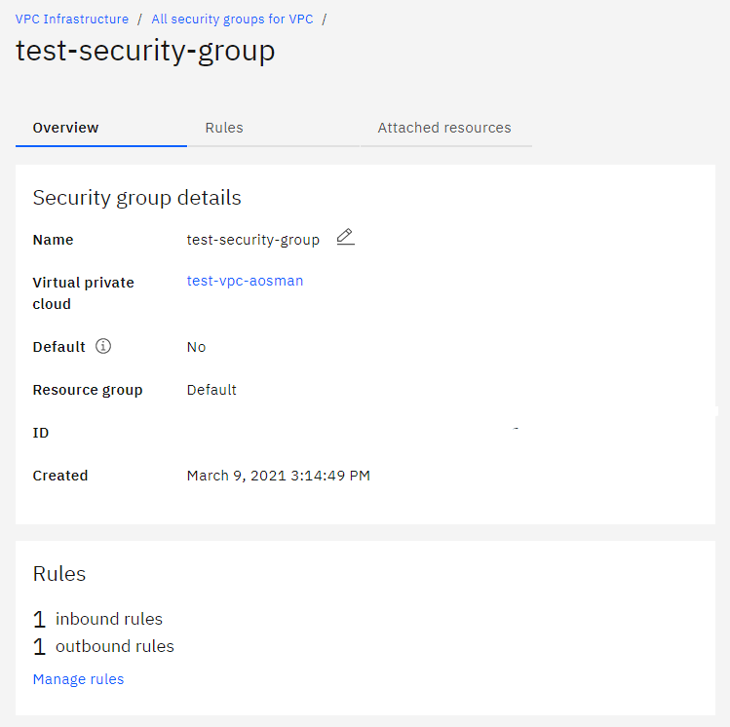
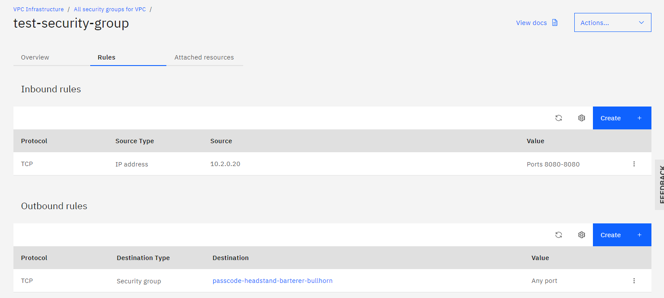
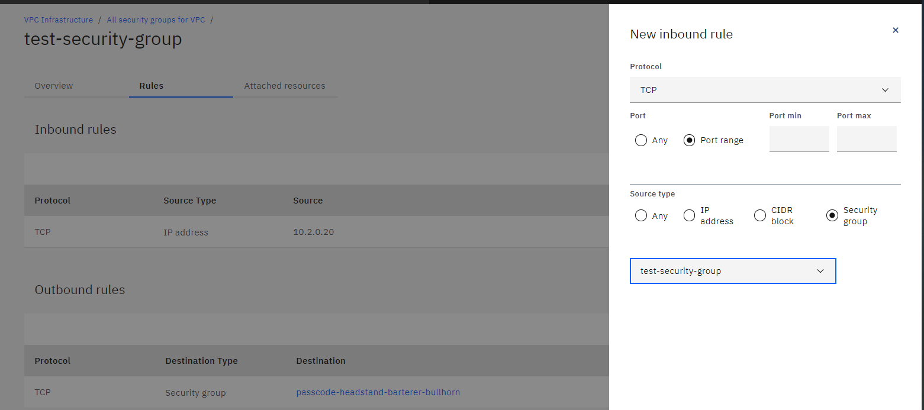
Creating a Security Group: Define Rules by Protocol (TCP, UDP, ICMP), Port Range, IP Address, CIDR or Security Group

Slide 5
Removal of existing restriction for Non-RFC-1918 addresses on IBM Cloud VPC
(GA 02 Feb 2021)
Available MZR Geographies:
US-South DAL
US-East WDC
EU-DE
EU-FR, EU-FR2
EU-GB
JP-TOK, JP-OSA
AU-SYD
Website & External Docs:
Docs:
https://cloud.ibm.com/docs/vpc?topic=vpc-create-vpc-route
Seismic: https://ibm.seismic.com/Link/Content/DCRw718mhpK0aPXIk3SlLFqA
Customer Benefits:
VPC Gen2 customers will be able to create private VPC address prefixes with non-RFC-1918 addresses
Expanded capability for IBM customers to easily configure connectivity from remote/on-premise networks to their VPCs via Direct Link or Transit Gateway
Greater flexibility and convenience to implement hybrid cloud solutions.
The feature is available on all Production environments via API, UI and CLI
Market:
Large Enterprises looking for hybrid cloud solutions, with flexibility of BYOIP.
IBM is modernizing our VPC Infrastructure to be more competitive with AWS, Microsoft and Google with our networking platform for public cloud.
This release completes another important milestone of the VPC Roadmap and will help with accelerating customer’s VPC Gen2 adoption, including migration of VPC Gen1 customers to VPC Gen2.

Slide 6
Resources in IBM Docs
Core custom routes for VPC docs: https://cloud.ibm.com/docs/vpc?topic=vpc-about-custom-routes (the last bullet under Limitations and guidelines)
Creating a route (new Delegate-VPC action): https://cloud.ibm.com/docs/vpc?topic=vpc-create-vpc-route
API: https://cloud.ibm.com/apidocs/vpc#create-vpc-routing-table-route
CLI (v0.7.8): https://cloud.ibm.com/docs/vpc?topic=vpc-infrastructure-cli-plugin-vpc-reference#custom-routes-section
Routing considerations for IANA-registered IP assignments: https://cloud.ibm.com/docs/vpc?topic=vpc-interconnectivity#routing-considerations-iana
Planning considerations for Transit Gateway and Direct Link (example) https://cloud.ibm.com/docs/transit-gateway?topic=transit-gateway-helpful-tips#vpc-connection-consideration

